Slide 1
Watson Assistant Service:
The assistant flow I am creating in this lab exercise is to demonstrate how the Assistant service uses Intents and Entities in a simple chat interface.
I am creating a simple Pizza order Chabot which takes below inputs to create an order:1.Size of Pizza (small, medium, large)2.Toppings (onion, tomato, etc.).
The Watson Assistant layer application using the Assistant Dialog skill, can take appropriate action based on that information. Usually, a combination of intent and entity results in a separate response or action.

Slide 2
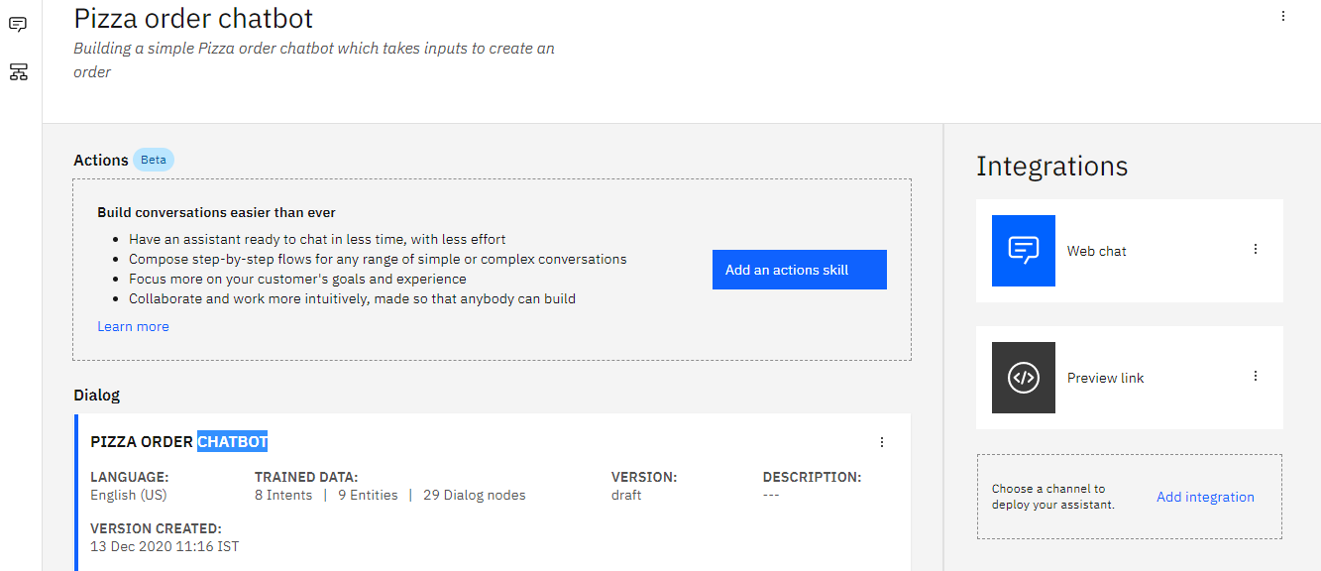
Watson Assistant Service:
Created my Assistant Service Instance. Accessed the IBM Cloud console by entering the URL and logging-in with my IBM Cloud ID.Located Assistant service by starting to type “assist…” into the search field. Selected Watson Assistant. Selected Lite option. Located and clicked and Created Watson Assistant. Typed a unique name and optional description,(i.e. Pizza order chatbot:Building a simple Pizza order Chabot which takes inputs to create an order) keeping default of Enable Preview Link and click Create assistant.
Located and clicked Add dialog skill. Typed a unique name and description and clicked Create dialog skill. Clicked on the Skill name to launch the tooling

Slide 3
Watson Assistant Service:
Assistant Service Instance: An Assistant service instance is created on the IBM Cloud console. The procedure is identical to that of creating other Watson services.
Assistant: An Assistant is the application layer that interacts with your end users.
Dialog skill: A skill is a unique development and test environment where business and technical users can update the logic for their assistant system. When calling the Watson Assistant Service API, you must specify a Skill ID. The service credentials for your service tile will remain across all 5 skills (20 skills for Standard plan) per tile.
Search Assistant allows to quickly find information within the Intent, Entities and Dialog pages.

Slide 4
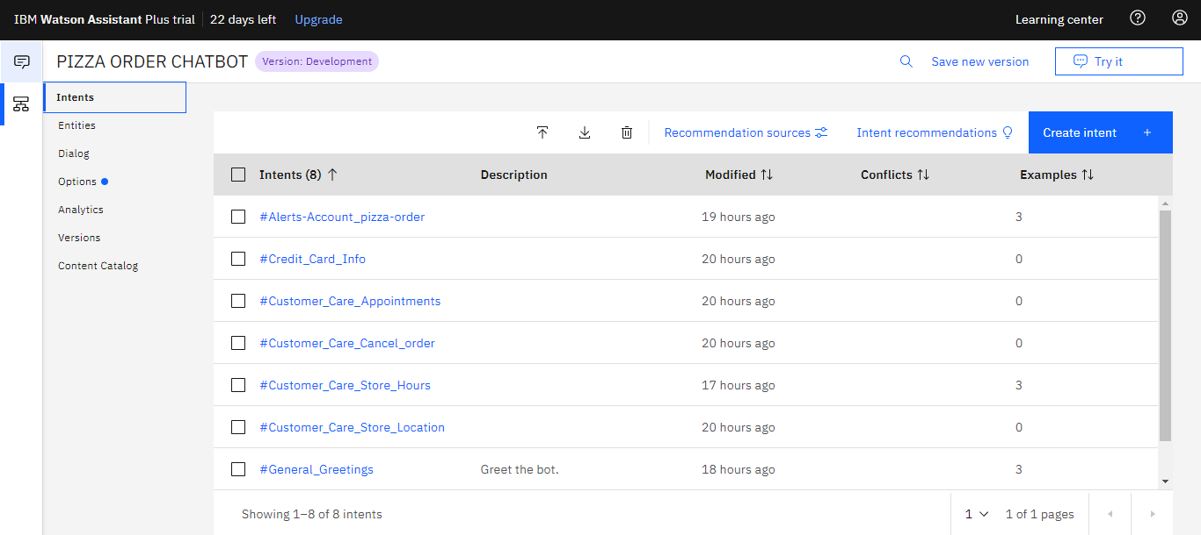
Domain Specific Intents:
In the Intents tab clicked on ‘Create Intent’ button to create new intents.
created the following intents:
#Intent name-Alerts-Account_pizza-order;User examples (3)-I want pizza delivered, take my pizza order, what are your timings for pizza orders.
#Customer_Care_Store_Hours;User examples (3)-opened?,closed?,Are you open on holidays?.
#Customer_Care_Store_Location;
#General_Greetings;User examples (3)-good day, good morning, good to see you.

Slide 5
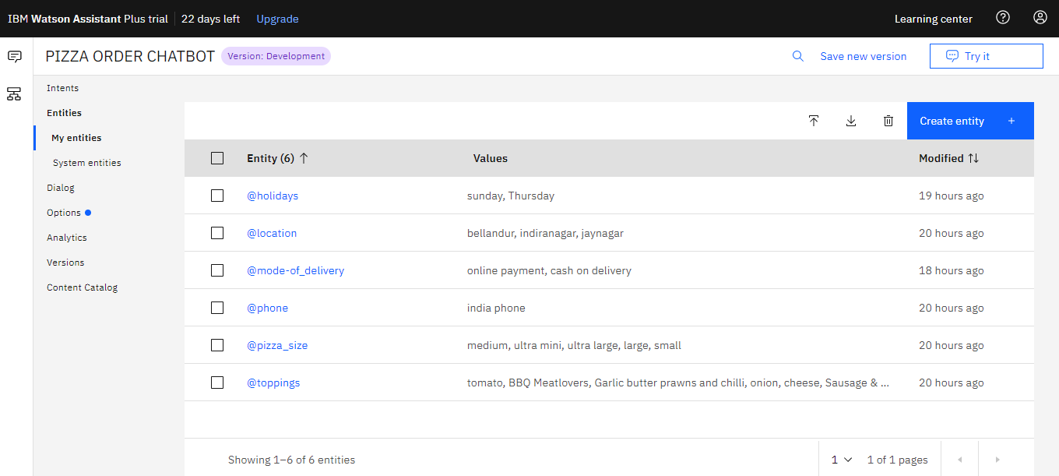
Entities in Watson Assistant:
Switched to the Entities tab.
In the Entities tab clicked on ‘Create Intent’ button to create new Entities.
created the following Entities:
1)Entity name-@holidays; Values (2)-Thursday, Sunday(synonyms-weekend)
2)Entity name-@location; Values (3)-bellandur,indiranagar,jaynagar
3)Entity name-@mode-of_delivery;Values (2)-cash on delivery, online payment(synonyms-online)
4)Entity name-@pizza_size;Values (5)-large,medium,small,ultra large, ultra mini
5)Entity name-@toppings; Values (6)-BBQ Meatlovers,cheese,Garlic butter prawns and chilli,onion,Sausage & Kale, tomato

Slide 6
Watson Assistant Service:
Planning Responses (Using Core Intents and Entities):
A response is what the Assistant service returns to the end-user based on the intents and entities it recognizes in inputs. Not all answers are text; some are actions.
Ground Truth is the grouping of end-user examples with intents. Watson Assistant service uses the Ground Truth mapping to train its cognitive models. The utterances in Ground Truth are collected from end users in line with question collection best practices.
The dialog uses the intents and entities, plus context from the application, to interact with the user and ultimately provide a useful response. The response might be the answer to a question, guide a user through a process, or execute a command.
The intent and entity might be enough information to identify the correct response, or the dialog might ask the user for more input that is needed to respond correctly.

Slide 7
Watson Assistant Service:
Conditions
we can use one or more of the following artifacts in any combination to define a condition:
Intent: The simplest condition is a single intent. The node is used if the user's input maps to that intent. we can Use the syntax #{intent-name}. For example, #weather checks if the intent detected in the user input is weather. If so, the node is processed.
Entity: The node is used when any value or synonym for the entity is recognized in the user input. We can Use the syntax @{entity name}.
Entity value: The node is used if the entity value is detected in the user input. we can Use the syntax @{entity name}:{value}. we can Specify a defined value for the entity, not a synonym.
Context variable: The node is used if the context variable equation that you specify is true. We can Use the syntax $variable_name:value or $variable name == 'value‘
Special conditions: anything else, conversation start, false, irrelevant, true, welcome.

Slide 8
Watson Assistant Service:
Good dialog design should reflect the solution’s positioning to create a coherent and compelling solution that behaves as envisaged by you and the client.
If the dialog design does not consistently reflect the positioning, the solution is less likely to achieve its purpose, deliver value, or meet the client’s expectations, so don’t take the easy option!
To Reflect the positioning, the dialog design must create behaviors that:
1. Help achieve the defined purpose
2. Consistently express the identified viewpoint
3. Reflect the specified proactivity
4. Reflect the tone and personality.

Slide 9
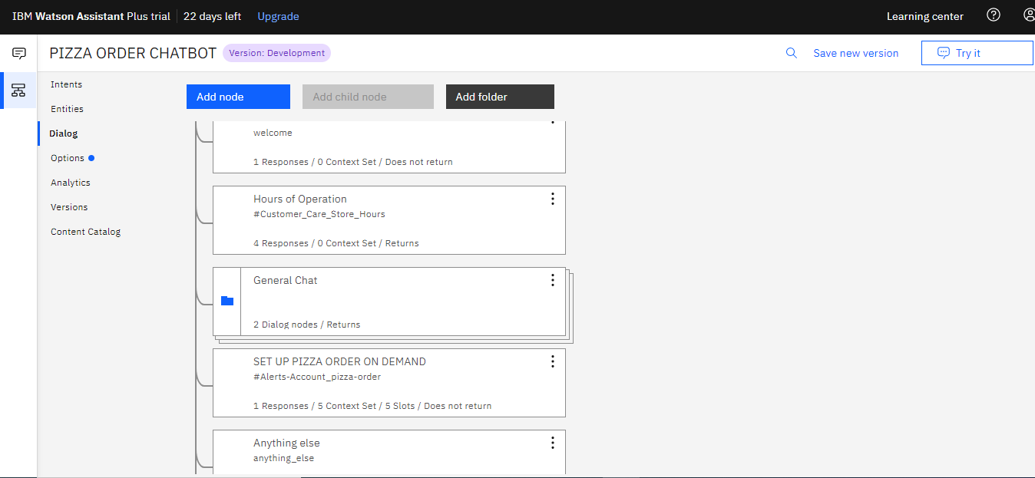
Create Dialog in Watson Assistant:
Switched to the Dialog tab.
Clicked Create.
Two nodes will automatically get created :
• Welcome - The welcome node is the first node in the dialog flow – typically a greeting message.
• Anything else - The anything else node gets hit if the system has low confidence in the intent, or if no other dialog conditions matched.

Slide 10
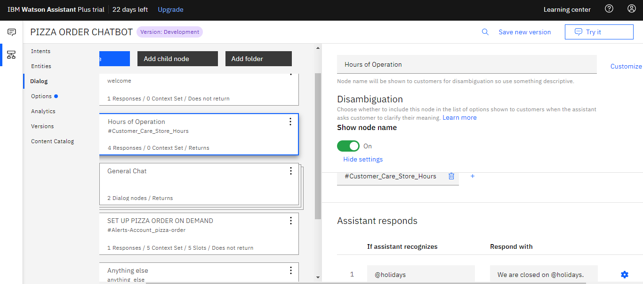
Create Dialog in Watson Assistant:
Created a Multi-conditional Response Node
Added a node under the welcome node
Named the node Hours of Operation
Condition on the #Customer_Care_Store_Hours intent
Clicked on Customize.
Enabled Multiple conditioned responses
Clicked Apply

Slide 11
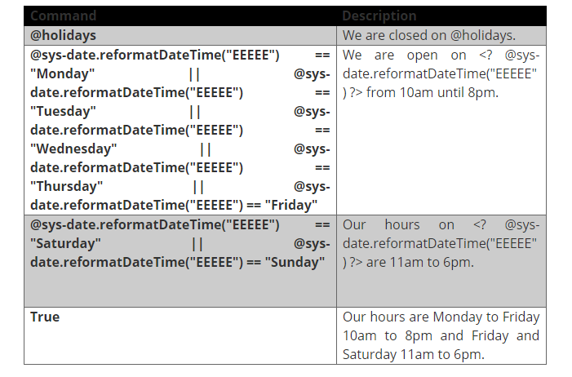
Create Dialog in Watson Assistant:
Added following responses for the node Hours of Operation as shown in the snapshots

Slide 12
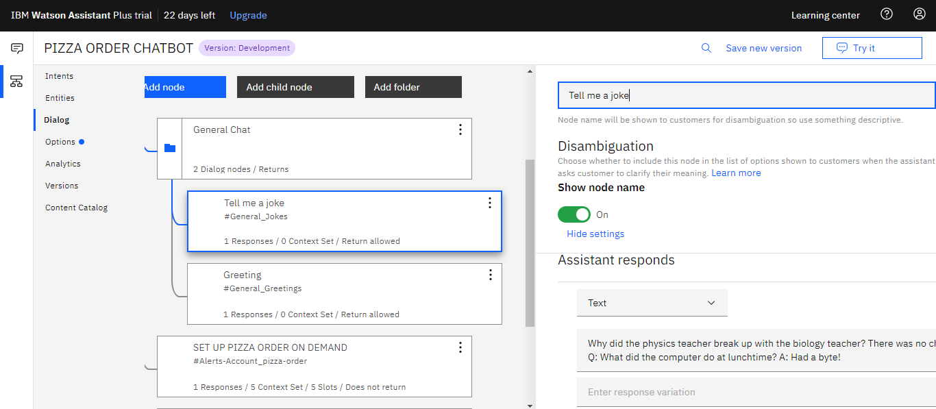
Create Dialog in Watson Assistant:
Added a folder.
Called the folder General Chat.

Slide 13
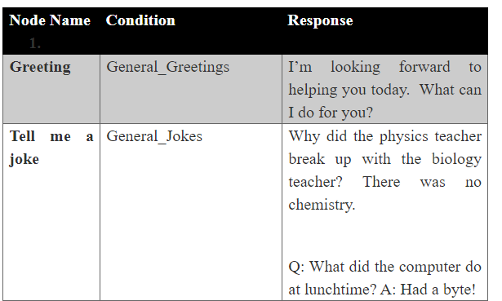
Create Dialog in Watson Assistant:
Created the Nodes in the table below for the added folder General Chat.
Configured the Slot Responses.
Add the following responses to SET UP PIZZA ORDER ON DEMAND slot as shown in the snapshot.

Slide 14
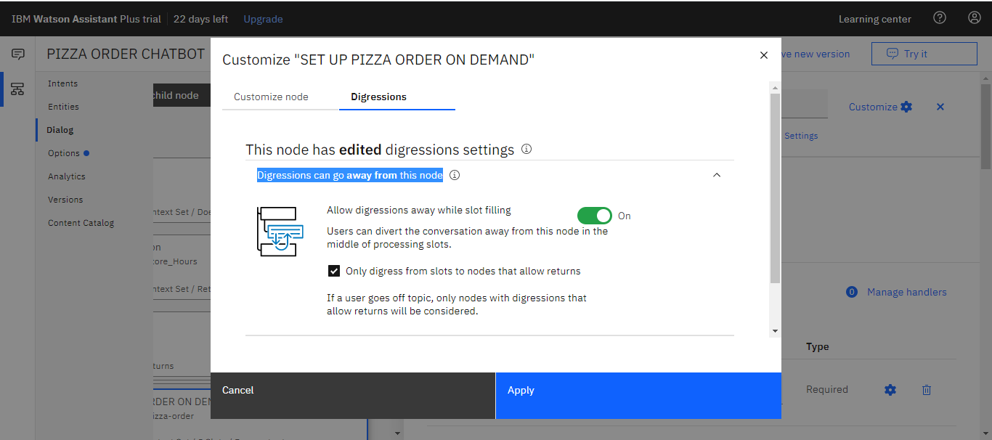
Create Dialog in Watson Assistant:
Made a SET UP PIZZA ORDER ON DEMAND node
Added a node under the General Chat Node
Named the node SET UP PIZZA ORDER ON DEMAND
Selected Customize
– Enabled Slots with Prompt for everything
– Enabled multiple conditioned responses
– Selected Apply
Selected Customize, Digressions
– Selected Allow digressions away while slot filling
– Selected only digress from slots to nodes that allow returns
– Selected Apply

Slide 15
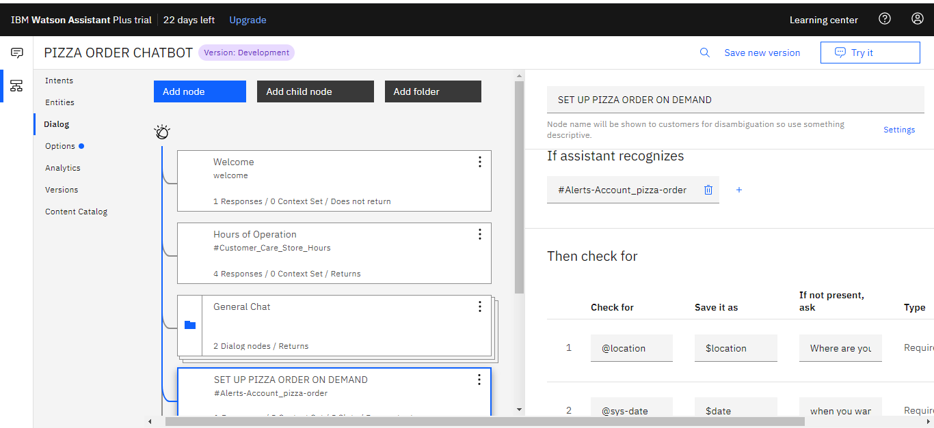
Create Dialog in Watson Assistant:
Configured the Slots for SET UP PIZZA ORDER ON DEMAND node
Condition on # Alerts-Account_pizza-order

Slide 16
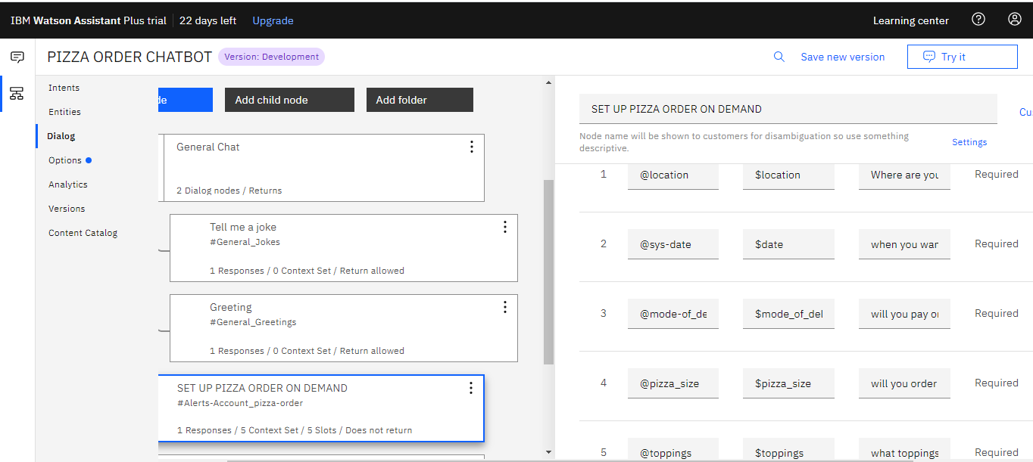
Create Dialog in Watson Assistant:
Added the slots for SET UP PIZZA ORDER ON DEMAND node as shown in the snapshots.

Slide 17
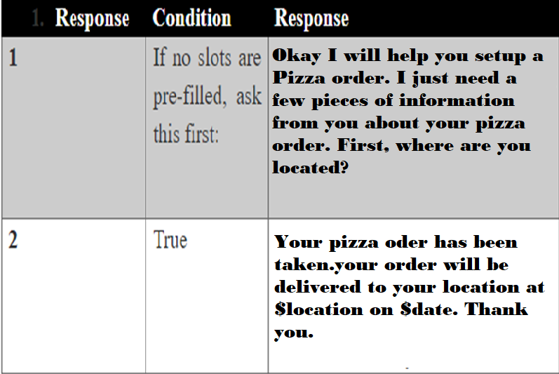
Create Dialog in Watson Assistant:
Configured the Slot Responses.
Added the following responses to SET UP PIZZA ORDER ON DEMAND slot as shown in the snapshot.

Slide 18
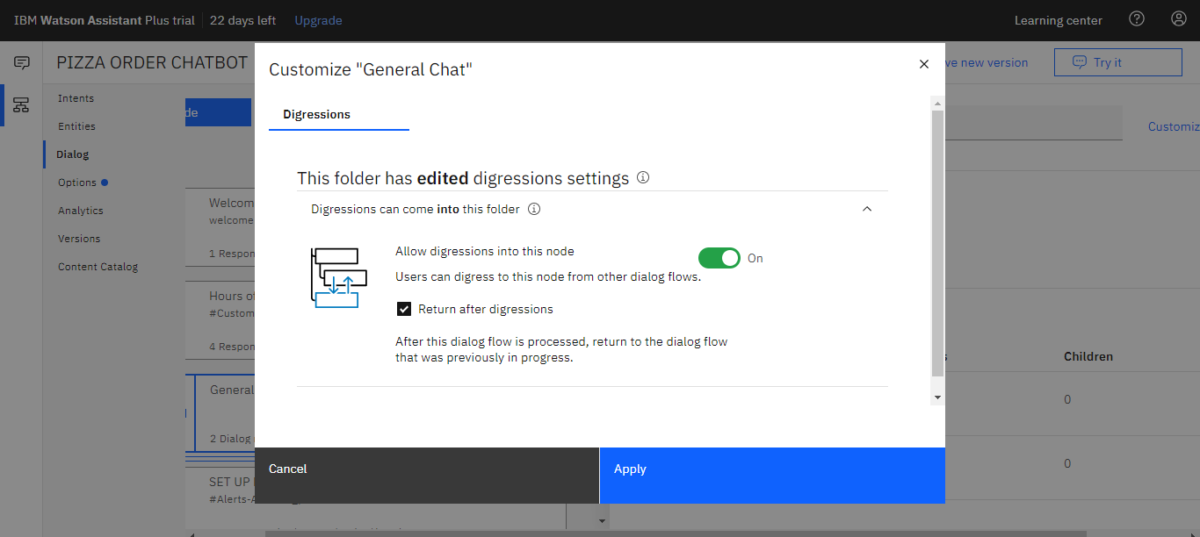
Create Dialog in Watson Assistant:
Digressions:
Digressions allows for answering a common question outside of a business process and then return the user to where they left off in the process.
Opened the General Chat folder
Selected Customize and Turned on “Digression” as well as check the “Return after digression” option.
repeated the same steps for other nodes as well .

Slide 19
Slots and Digressions:
Digressions allows for answering a common question outside of a business process and then return the user to where they left off in the process.
we do not define the start and end of a digression. The user is entirely in control of the digression flow at run time. we only specify how each node should or should not participate in a user-led digression. For each node, we configure whether:
a digression can start from and leave the node. Digression that starts elsewhere can target and enter the node. A digression that starts elsewhere and enters the node must return to the interrupted dialog flow after the current dialog flow is completed
Slots are a configuration option within dialog to collect multiple pieces of information as needed to complete a complex task for a user, such as making a dinner reservation. Software products, unit testing etc. are some of the automated processes.

Slide 20
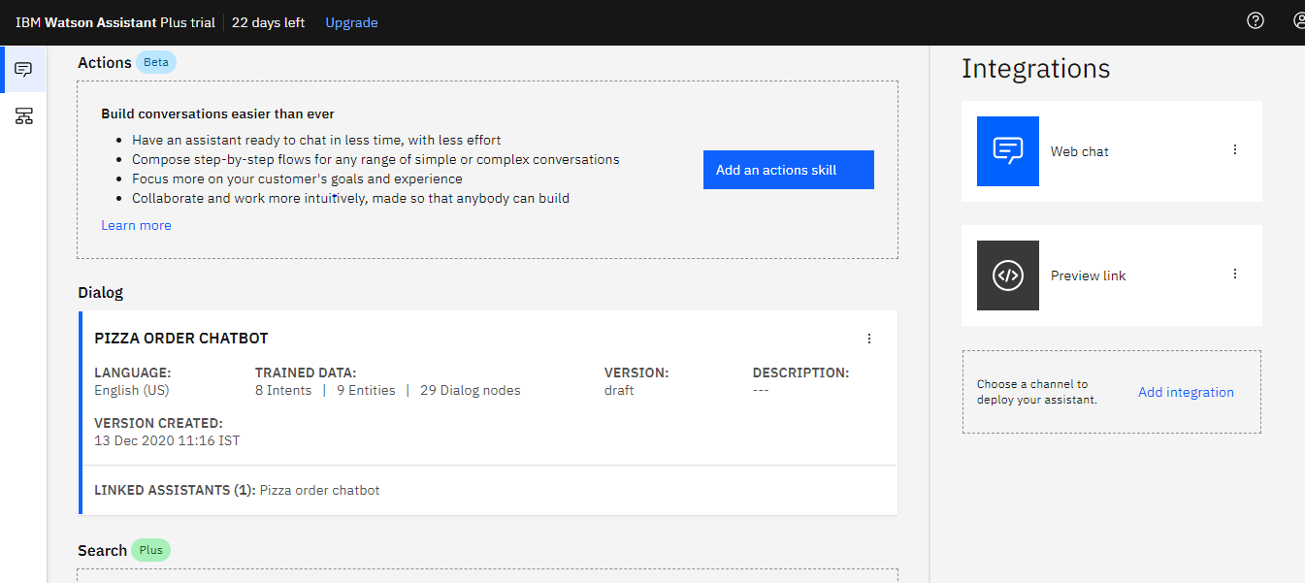
Versioning and testing my Assistant in Watson Assistant:
Navigated to Assistants in Left hand pane
Selected my Assistant
Clicked on Preview Link
Clicked on the Link to Try it
Tried out my Assistant!

Slide 21
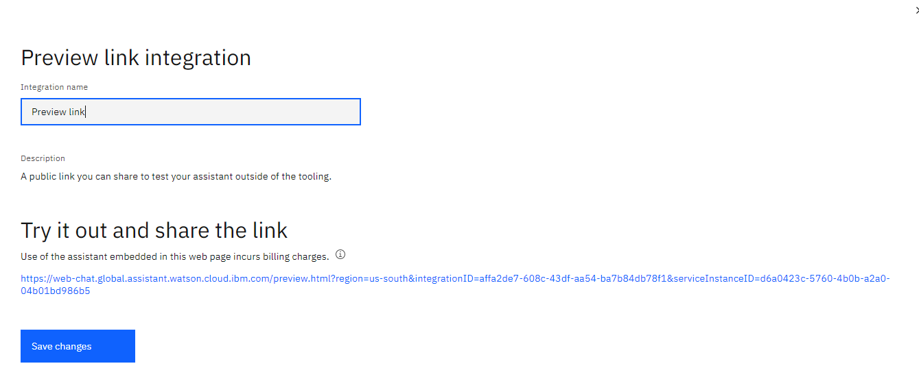
Versioning and testing my Assistant in Watson Assistant:
Tried it out and sharing the link of the assistant embedded in the web page as below:

Slide 22
Versioning and testing my Assistant in Watson Assistant:
https://web-chat.global.assistant.watson.cloud.ibm.com/preview.html?region=us-south&integrationID=affa2de7-608c-43df-aa54-ba7b84db78f1&serviceInstanceID=d6a0423c-5760-4b0b-a2a0-04b01bd986b5

Slide 23
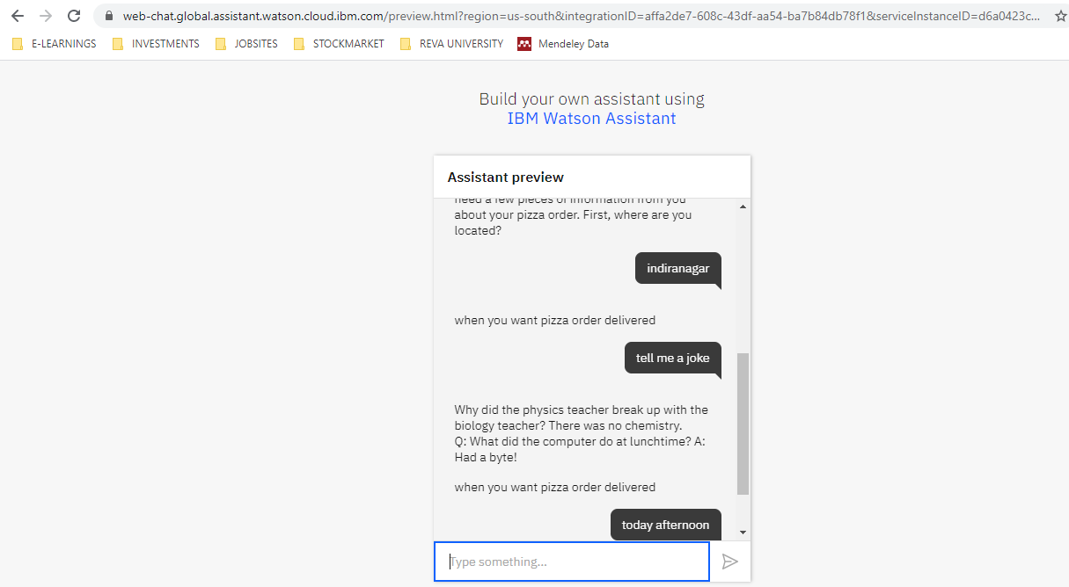
Versioning and testing my Assistant in Watson Assistant:
Deploying the bot using preview link.
Allowing digression during the order to answer general questions.

Slide 24
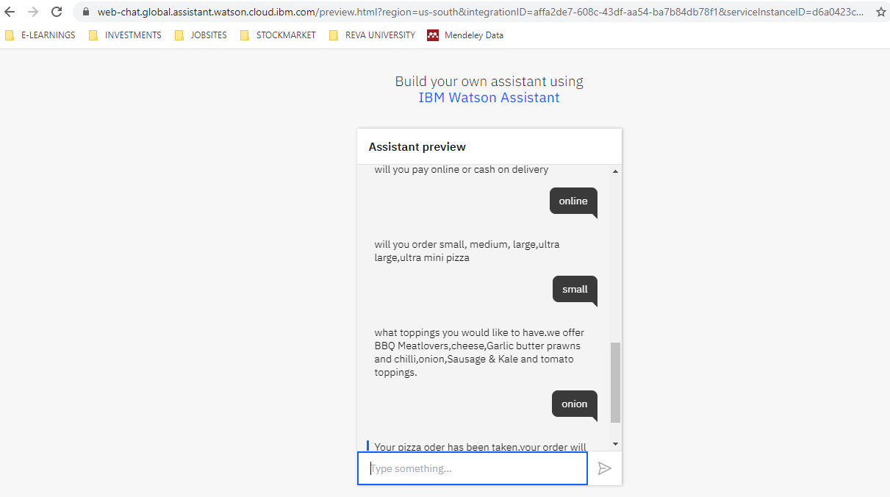
Versioning and testing my Assistant in Watson Assistant:
Built a simple Pizza order chatbot which takes below inputs to create an order:1.Size of Pizza (small, medium, large)2.Toppings (onion, tomato, etc.)

